Slide 1
UNCERTAINTIES IN FLOOD ASSESSMENT AND CORRECTIONS IN EXISTING DAMS : CASE STUDY OF BANAS BASIN, GUJARAT, INDIA

Slide 2
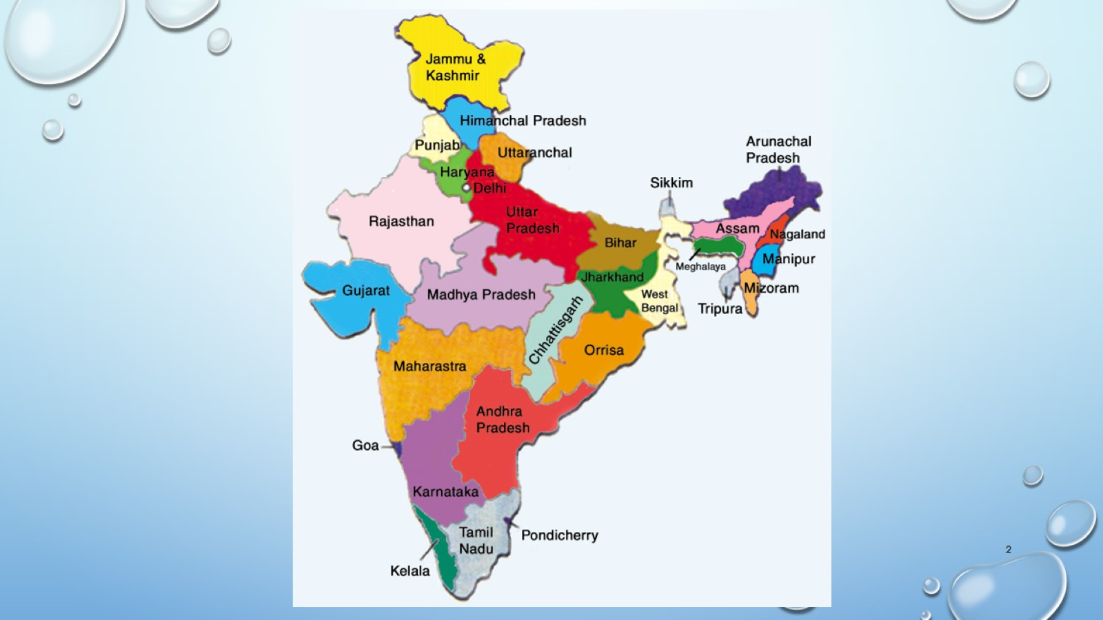

Slide 3
OVERVIEW OF BANAS BASIN

Slide 4
DANTIWADA DAM

Slide 5
DANTIWADA DAM

Slide 6
DANTIWADA DAM - LIMITATIONS AT DESIGN STAGE

Slide 7
SIPU DAM

Slide 8
SIPU DAM

Slide 9
DANTIWADA DAM – design flood outperformed

Slide 10
DANTIWADA DAM – design flood outperformed

Slide 11
DANTIWADA DAM – HYDROLOGY REVISED

Slide 12
DANTIWADA DAM – HYDROLOGY REVISED

Slide 13
RECENT FLOODS – HYDROLOGY TESTED FOR BOTH THE DAMS

Slide 14
RECENT FLOODS – HYDROLOGY TESTED FOR BOTH THE DAMS

Slide 15
RECENT FLOODS – HYDROLOGY TESTED FOR BOTH THE DAMS

Slide 16
RECENT FLOODS – HYDROLOGY TESTED FOR BOTH THE DAMS

Slide 17
RECENT FLOODS – HYDROLOGY TESTED FOR BOTH THE DAMS

Slide 18
CONCLUSION

